Slide 1
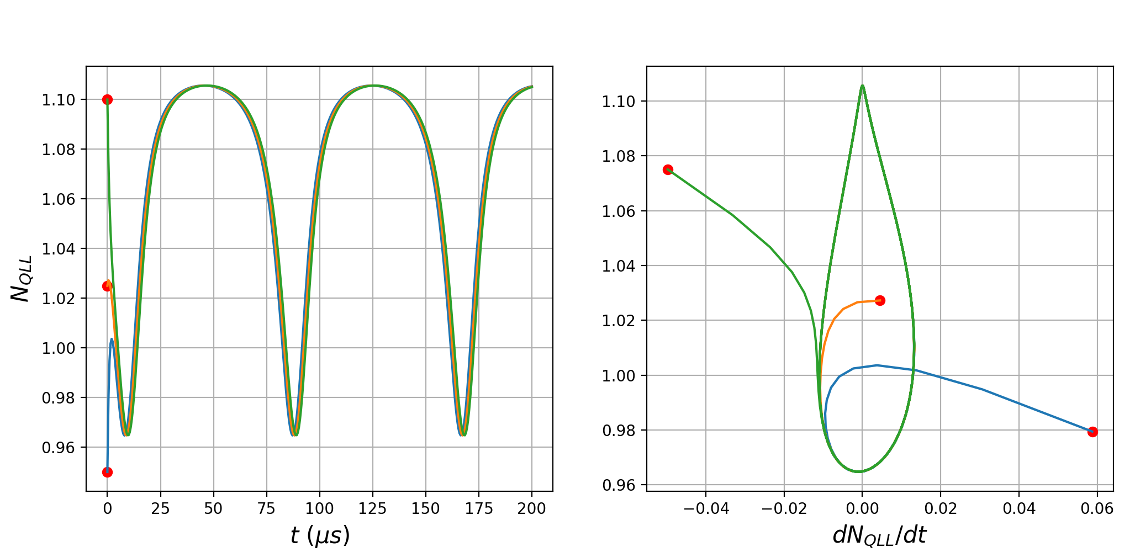
(a)
(b)
II
II
II
I
I
I

